Slide 1

DEPARTMENT OF COMPUTER SCIENCE AND ENGINEERING
Project name : Smart Water Fountain
Team name : Proj_224781_Team_6
Team members :
KIRUTHIKA K(113321104046)
KUNCHALA SRIHEMA(113321104049)
LAVANYA V(113321104050)
MAHI MITHRA R(113321104054)

Slide 2
Innovation
Smart Water Fountain aims to upgrade the public water fountain system by implementing IoT sensors to the traditional water fountain. Our goal is to design a smart water fountain that can monitor the water quality and automatically replace water when polluted(not healthy) or running out. We will use sensors to measure the water quality.
Maintenance Alerts: Smart water fountains can send alerts when they require maintenance or repairs, reducing downtime and ensuring that they remain in good working condition.
Energy Efficiency: Many smart water fountains are designed to be energy-efficient, with features like low-power modes, LED lighting, and solar panels. This reduces the environmental impact and lowers operational costs.

Slide 3
Innovation
Integration with IoT Devices: Integration with other smart home or office devices enables seamless control and monitoring through smartphones or smart assistants, enhancing convenience and user experience.
Smart Features: A fountain that works only when it detects people around it, making it energy efficient
Customization: Smart decorative fountains often come with customizable features, such as water flow patterns, color-changing LED lighting, and music integration

Slide 4
Objectives
Through a network of sensors, the system collects real-time data on water quality. This data is processed in cloud based platform.
Ensure water quality maintenance and address water management challenges, including water usage and tank overflow.
Monitor parameters such as water flow rate, pressure, temperature, pH levels, turbidity, and contaminants
Use wireless communication protocols to transmit data securely and efficiently

Slide 5
IoT Sensor Design
Water Level Sensor: Automatically controls the minimum and maximum water levels of architectural fountains.
Distance Sensor: Combine the distance sensor with an LED display or water jets that respond to the user's proximity. As someone gets closer, the water flow might increase, change color, or create patterns, providing an interactive and visually appealing experience.
Water Flow Sensor: It is used to know the usage of water litre per hour. By using ESP8266 WI-FI module the data is recorded in real-time and updated in cloud.

Slide 6
Iot Sensor Design
Pressure Sensors: Pressure sensors can be used to monitor water pressure within the fountain system, helping to ensure proper water distribution and flow rates.
Water Usage and Consumption Sensors: These sensors can monitor and record water consumption, which is valuable for both conservation and maintenance purposes.
Light Sensors: Light sensors can detect ambient lighting conditions and adjust the fountain's lighting to provide the best visual effects, such as changing colors during different times of the day or night.

Slide 7
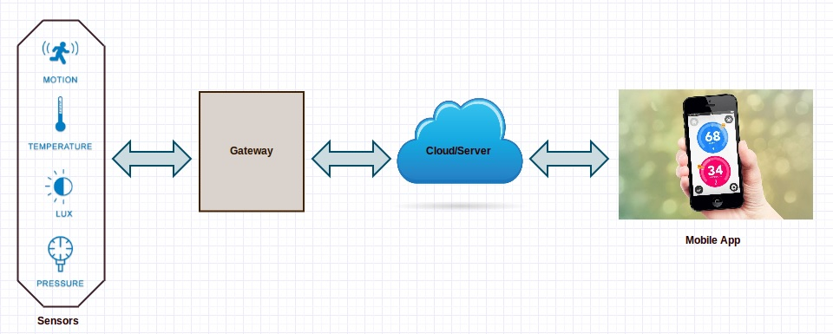
Diagram

Slide 8
Design Features
Enhances the water fountain's visual allure and attractiveness.
Remote control monitoring simplifies the process of controlling and maintaining systems.
Wireless communications use a low-power unlicensed band for improved security and power savings.
features that help prevent algae and scale buildup, reducing the need for frequent cleaning.

Slide 9
Conclusion
A smart water fountain using IoT sensors is technologically advanced. Aesthetically pleasing water feature designed for both visual enjoyment and functional utility. These fountains are equipped with various sensors, automation systems, and digital components that enhance their appeal, interactivity, and management. By combining IoT sensors and connectivity, they contribute to reduced water wastage, enhanced user experience, and better resource management.These fountains offer remote control capabilities, water management and they are energy efficient.

Slide 10
THANK YOU
.

